Slide 1
Building Java Programs
Chapter 2
Lecture 2-3: Loop Figures and Constants
reading: 2.4 - 2.5
Notes:
1

Slide 3
Drawing complex figures
#================#
| <><> |
| <>....<> |
| <>........<> |
|<>............<>|
|<>............<>|
| <>........<> |
| <>....<> |
| <><> |
#================#
Use nested for loops to produce the following output.
Why draw ASCII art?
Real graphics require a lot of finesse
ASCII art has complex patterns
Can focus on the algorithms

Slide 4
Development strategy
#================#
| <><> |
| <>....<> |
| <>........<> |
|<>............<>|
|<>............<>|
| <>........<> |
| <>....<> |
| <><> |
#================#
Recommendations for managing complexity:
1. Design the program (think about steps or methods needed).
write an English description of steps required
use this description to decide the methods
2. Create a table of patterns of characters
use table *AND USE ALGEBRA* to write
your for loops

Slide 5
1. Pseudo-code
************
* *
* *
* *
* *
* *
************
pseudo-code: An English description of an algorithm.
Example: Drawing a 12 wide by 7 tall box of stars
print 12 stars.
for (each of 5 lines) {
print a star.
print 10 spaces.
print a star.
}
print 12 stars.

Slide 6
Pseudo-code algorithm
#================#
| <><> |
| <>....<> |
| <>........<> |
|<>............<>|
|<>............<>|
| <>........<> |
| <>....<> |
| <><> |
#================#
1. Line
# , 16 =, #
2. Top half
|
spaces (decreasing)
<>
dots (increasing)
<>
spaces (same as above)
|
3. Bottom half (top half upside-down)
4. Line
# , 16 =, #

Slide 7
Methods from pseudocode
public class Mirror {
public static void main(String[] args) {
line();
topHalf();
bottomHalf();
line();
}
public static void topHalf() {
for (int line = 1; line <= 4; line++) {
// contents of each line
}
}
public static void bottomHalf() {
for (int line = 1; line <= 4; line++) {
// contents of each line
}
}
public static void line() {
// ...
}
}

Slide 8
2. Tables
line | spaces |  | dots
1 | 6 |  | 0
2 | 4 |  | 4
3 | 2 |  | 8
4 | 0 |  | 12
line | spaces | -2 * line + 8 | dots | 4 * line - 4
1 | 6 | 6 | 0 | 0
2 | 4 | 4 | 4 | 4
3 | 2 | 2 | 8 | 8
4 | 0 | 0 | 12 | 12
#================#
| <><> |
| <>....<> |
| <>........<> |
|<>............<>|
|<>............<>|
| <>........<> |
| <>....<> |
| <><> |
#================#
A table for the top half:
Compute spaces and dots expressions from line number

Slide 9
3. Writing the code
#================#
| <><> |
| <>....<> |
| <>........<> |
|<>............<>|
|<>............<>|
| <>........<> |
| <>....<> |
| <><> |
#================#
Useful questions about the top half:
What methods? (think structure and redundancy)
Number of (nested) loops per line?

Slide 10
Partial solution
// Prints the expanding pattern of <> for the top half of the figure.
public static void topHalf() {
for (int line = 1; line <= 4; line++) {
System.out.print("|");
for (int space = 1; space <= (line * -2 + 8); space++) {
System.out.print(" ");
}
System.out.print("<>");
for (int dot = 1; dot <= (line * 4 - 4); dot++) {
System.out.print(".");
}
System.out.print("<>");
for (int space = 1; space <= (line * -2 + 8); space++) {
System.out.print(" ");
}
System.out.println("|");
}
}

Slide 11
Class constants and scope
reading: 2.4
Notes:
11

Slide 12
Scaling the mirror
#================#
| <><> |
| <>....<> |
| <>........<> |
|<>............<>|
|<>............<>|
| <>........<> |
| <>....<> |
| <><> |
#================#
#============#
| <><> |
| <>....<> |
|<>........<>|
|<>........<>|
| <>....<> |
| <><> |
#============#
Let's modify our Mirror program so that it can scale.
The current mirror (left) is at size 4; the right is at size 3.
We'd like to structure the code so we can scale the figure by changing the code in just one place.

Slide 13
Limitations of variables
Idea: Make a variable to represent the size.
Use the variable's value in the methods.
Problem: A variable in one method can't be seen in others.
public static void main(String[] args) {
int size = 4;
topHalf();
printBottom();
}
public static void topHalf() {
for (int i = 1; i <= size; i++) { // ERROR: size not found
...
}
}
public static void bottomHalf() {
for (int i = size; i >= 1; i--) { // ERROR: size not found
...
}
}
Notes:
13

Slide 14
Scope
x's scope
i's scope
scope: The part of a program where a variable exists.
From its declaration to the end of the { } braces
A variable declared in a for loop exists only in that loop.
A variable declared in a method exists only in that method.
public static void example() {
int x = 3;
for (int i = 1; i <= 10; i++) {
System.out.println(x);
}
// i no longer exists here
}
// x ceases to exist here

Slide 15
Scope implications
Variables without overlapping scope can have same name.
for (int i = 1; i <= 100; i++) {
System.out.print("/");
}
for (int i = 1; i <= 100; i++) { // OK
System.out.print("\\");
}
int i = 5; // OK: outside of loop's scope
A variable can't be declared twice or used out of its scope.
for (int i = 1; i <= 100 * line; i++) {
int i = 2; // ERROR: overlapping scope
System.out.print("/");
}
i = 4; // ERROR: outside scope

Slide 16
Class constants
class constant: A fixed value visible to the whole program.
value can be set only at declaration; cannot be reassigned, hence the name: constant
Syntax:
public static final type name = expression;
name is usually in ALL_UPPER_CASE
Examples:
public static final int HOURS_IN_WEEK = 7 * 24;
public static final double INTEREST_RATE = 3.5;
public static final int SSN = 658234569;

Slide 17
Constants and figures
Consider the task of drawing the following scalable figure:
+/\/\/\/\/\/\/\/\/\/\+
| |
| |
| | Multiples of 5 occur many times
| |
| |
+/\/\/\/\/\/\/\/\/\/\+
+/\/\/\/\+
| |
| | The same figure at size 2
+/\/\/\/\+
Notes:
17

Slide 18
Repetitive figure code
public class Sign {
public static void main(String[] args) {
drawLine();
drawBody();
drawLine();
}
public static void drawLine() {
System.out.print("+");
for (int i = 1; i <= 10; i++) {
System.out.print("/\\");
}
System.out.println("+");
}
public static void drawBody() {
for (int line = 1; line <= 5; line++) {
System.out.print("|");
for (int spaces = 1; spaces <= 20; spaces++) {
System.out.print(" ");
}
System.out.println("|");
}
}
}
Notes:
18

Slide 19
Adding a constant
public class Sign {
public static final int HEIGHT = 5;
public static void main(String[] args) {
drawLine();
drawBody();
drawLine();
}
public static void drawLine() {
System.out.print("+");
for (int i = 1; i <= HEIGHT * 2; i++) {
System.out.print("/\\");
}
System.out.println("+");
}
public static void drawBody() {
for (int line = 1; line <= HEIGHT; line++) {
System.out.print("|");
for (int spaces = 1; spaces <= HEIGHT * 4; spaces++) {
System.out.print(" ");
}
System.out.println("|");
}
}
}
Notes:
19

Slide 20
Complex figure w/ constant
A mirror of size 3:
#============#
| <><> |
| <>....<> |
|<>........<>|
|<>........<>|
| <>....<> |
| <><> |
#============#
Modify the Mirror code to be resizable using a constant.
A mirror of size 4:
#================#
| <><> |
| <>....<> |
| <>........<> |
|<>............<>|
|<>............<>|
| <>........<> |
| <>....<> |
| <><> |
#================#

Slide 21
Using a constant
Constant allows many methods to refer to same value:
public static final int SIZE = 4;
public static void main(String[] args) {
topHalf();
bottomHalf();
}
public static void topHalf() {
for (int i = 1; i <= SIZE; i++) { // OK
...
}
}
public static void bottomHalf() {
for (int i = SIZE; i >= 1; i--) { // OK
...
}
}
Notes:
21

Slide 22
Loop tables and constant
SIZE | line | spaces | -2*line + (2*SIZE) | dots | 4*line - 4
4 | 1,2,3,4 | 6,4,2,0 | -2*line + 8 | 0,4,8,12 | 4*line - 4
3 | 1,2,3 | 4,2,0 | -2*line + 6 | 0,4,8 | 4*line - 4
SIZE | line | spaces |  | dots
4 | 1,2,3,4 | 6,4,2,0 |  | 0,4,8,12
3 | 1,2,3 | 4,2,0 |  | 0,4,8
SIZE | line | spaces |  | dots
4 | 1,2,3,4 | 6,4,2,0 | -2*line + 8 | 0,4,8,12 | 4*line - 4
3 | 1,2,3 | 4,2,0 | -2*line + 6 | 0,4,8 | 4*line - 4
Let's modify our loop table to use SIZE
This can change the amount added in the loop expression
#================# #============#
| <><> | | <><> |
| <>....<> | | <>....<> |
| <>........<> | |<>........<>|
|<>............<>| |<>........<>|
|<>............<>| | <>....<> |
| <>........<> | | <><> |
| <>....<> | #============#
| <><> |
#================#

Slide 23
Partial solution
public static final int SIZE = 4;
// Prints the expanding pattern of <> for the top half of the figure.
public static void topHalf() {
for (int line = 1; line <= SIZE; line++) {
System.out.print("|");
for (int space = 1; space <= (line * -2 + (2*SIZE)); space++) {
System.out.print(" ");
}
System.out.print("<>");
for (int dot = 1; dot <= (line * 4 - 4); dot++) {
System.out.print(".");
}
System.out.print("<>");
for (int space = 1; space <= (line * -2 + (2*SIZE)); space++) {
System.out.print(" ");
}
System.out.println("|");
}
}

Slide 24
Observations about constant
The constant can change the "intercept" in an expression.
Usually the "slope" is unchanged.
public static final int SIZE = 4;
for (int space = 1; space <= (line * -2 + (2 * SIZE)); space++) {
System.out.print(" ");
}
It doesn't replace every occurrence of the original value.
for (int dot = 1; dot <= (line * 4 - 4); dot++) {
System.out.print(".");
}

Slide 25
MM* MM* * * MM* * * * * MM* * * * * * *
Row # | # “* “’s
1 1
2 3
3 5
4 7
# “* “ = 2 * row# - 1
Create a program to accomplish the following:
Write a method that uses a nested for loop to draw this figure.
Make the loop scalable by adding a class constant named SIZE to control the number of rows.

Slide 26
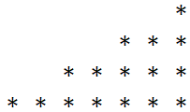
# asterisk = 2 * row# - 1
Row # | spaces
Row # | asterisks
1 12
2 8
3 4
4 2
1 1
2 3
3 5
4 7
# spaces = -4 * row# + 16
Create a program to accomplish the following:
Write a method that uses a nested for loop to draw this figure.
Make the loop scalable by adding a class constant named SIZE to control the number of rows.

Slide 27
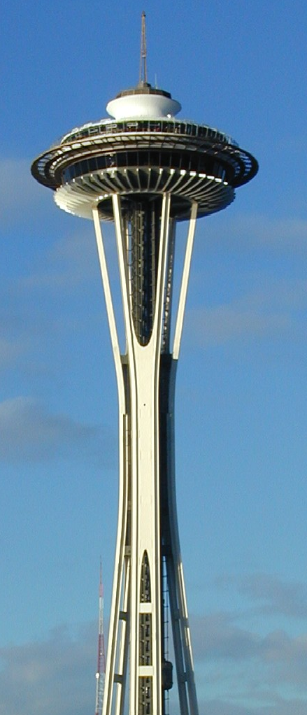
Assignment 2: ASCII Art
||
||
||
||
__/||\__
__/:::||:::\__
__/::::::||::::::\__
__/:::::::::||:::::::::\__
|""""""""""""""""""""""""|
\_/\/\/\/\/\/\/\/\/\/\/\_/
\_/\/\/\/\/\/\/\/\/\_/
\_/\/\/\/\/\/\/\_/
\_/\/\/\/\/\_/
||
||
||
||
|%%||%%|
|%%||%%|
|%%||%%|
|%%||%%|
|%%||%%|
|%%||%%|
|%%||%%|
|%%||%%|
|%%||%%|
|%%||%%|
|%%||%%|
|%%||%%|
|%%||%%|
|%%||%%|
|%%||%%|
|%%||%%|
__/||\__
__/:::||:::\__
__/::::::||::::::\__
__/:::::::::||:::::::::\__
|""""""""""""""""""""""""|

